Slide 1
Software Engineering
Wei-Min Wu（吴为民）
School of Petroleum
China University of Petroleum - Beijing at Karamay
Fall, 2025

Slide 2
Chap. 10 Dependable Systems
Topics covered
Dependability properties 可依赖属性
Sociotechnical systems 社会技术系统
Redundancy and diversity 冗余和多样性
Dependable processes 可依赖过程
Formal methods and dependability (留作自学)

Slide 3
Chap. 10 Dependable Systems
System dependability 系统可依赖性
Because software-intensive systems are so important to governments, companies, and individuals, we have to be able to trust these systems. The software should be available when it is needed, and it should operate correctly without undesirable side effects, such as unauthorized information disclosure. In short, we should be able to depend on our software systems. 软件密集型系统如此重要,必须可信赖
The term dependability was proposed to cover the related systems attributes of availability, reliability, safety, and security. These properties are inextricably linked, so having a single term to cover them all makes sense. 术语“可依赖性”的由来

Slide 4
Chap. 10 Dependable Systems
The dependability of systems is usually more important than their detailed functionality for the following reasons: 可依赖性通常比详细的功能更重要
System failures affect a large number of people: System failures that affect the availability of a system potentially affect all users of the system. 系统失效影响大量人
Users often reject systems that are unreliable, unsafe, or insecure: If a system is unreliable or insecure, users will refuse to use it. 用户经常拒绝不可靠、不安全或信息安全有问题的系统
System failure costs may be enormous: Failures in systems that control critical infrastructure such as the power network have widespread economic consequences. 系统失效的代价是巨大的
Undependable systems may cause information loss: The cost of recovering lost or corrupt data is usually very high. 不可依赖的系统可能导致信息丢失

Slide 5
Chap. 10 Dependable Systems
Causes of failure 失效的原因
Hardware failure: System hardware may fail because of mistakes in its design, because components fail as a result of manufacturing errors, because of environmental factors such as dampness or high temperatures, or because components have reached the end of natural life. 硬件失效
Software failure: System software may fail because of mistakes in its specification, design, or implementation. 软件失效
Operational failure: Human users may fail to use or operate the system as intended by its designers. As hardware and software have become more reliable, failures in operation are now, perhaps, the largest single cause of system failures. 操作失效

Slide 6
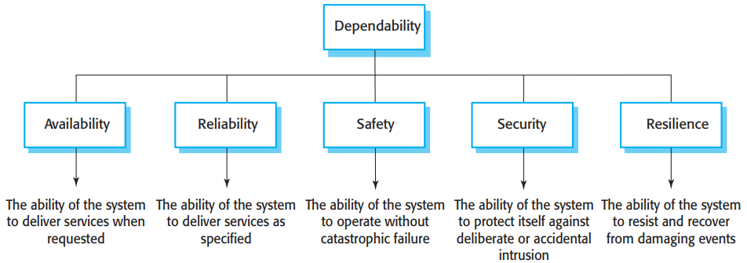

Chap. 10 Dependable Systems
10.1 Dependability properties 可依赖属性
There are five principal dimensions to dependability, as I have shown in Figure 10.1.
• The dependability properties shown in Figure 10.1 are complex properties that can be broken down into several simpler properties.
• Of course, not all dependability properties are critical for all systems.

Slide 7
Chap. 10 Dependable Systems
Principal properties 主要的可依赖性质
Availability: is the probability that it will be up and running and able to deliver useful services to users at any given time. 可用性
Reliability: is the probability, over a given period of time, that the system will correctly deliver services as expected by the user. 可靠性
Safety: is a judgment of how likely it is that the system will cause damage to people or its environment. 安全性
Security: is a judgment of how likely it is that the system can resist accidental or deliberate intrusions. 信息安全性
Resilience: is a judgment of how well that system can maintain the continuity of its critical services in the presence of disruptive events. 韧性

Slide 8
Chap. 10 Dependable Systems
Other dependability properties
Repairability: System failures are inevitable, but the disruption caused by failure can be minimized if the system can be repaired quickly. 可维修性
Maintainability: As systems are used, new requirements emerge, and it is important to maintain the value of a system by changing it to include these new requirements. 可维护性
Error tolerance: This property can be considered as part of usability and reflects the extent to which the system has been designed, so that user input errors are avoided and tolerated. 容错

Slide 9
Chap. 10 Dependable Systems
Inter-dependencies among dependability attributes 可依赖属性之间的相互依赖
Dependability properties of availability, security, reliability, safety, and resilience are closely related.可依赖属性之间密切相关
Safe system operation usually depends on the system being available and operating reliably. 安全依赖可用和可靠
A system may become unreliable because an intruder has corrupted its data. 可靠依赖信息安全
Denial-of-service attacks on a system are intended to compromise the system’s availability. 可用依赖信息安全
If a system is infected with a virus, you cannot then be confident in its reliability or safety because the virus may change its behavior. 可靠和安全依赖信息安全

Slide 10
Chap. 10 Dependable Systems
To develop dependable software, you need to ensure that: 要开发可依赖软件，要确保:
Avoid the introduction of accidental errors into the system during software specification and development. 避免引入意外错误
Design verification and validation processes that are effective in discovering residual errors that affect the dependability of the system. 设计有效的验证和确认过程
Design the system to be fault tolerant so that it can continue working when things go wrong. 将系统设计成可容错

Slide 11
Chap. 10 Dependable Systems
To develop dependable software, you need to ensure that: 要开发可依赖软件，要确保:（续）
Design protection mechanisms that guard against external attacks that compromise the availability or security of the system. 设计保护机制防范外部攻击
Configure the deployed system and its supporting software correctly for its operating environment. 正确配置已部署系统及其支持软件
Include system capabilities to recognize external cyberattacks and to resist these attacks. 包含识别和抵御外部网络攻击的能力
Design systems so that they quickly recover from system failures and cyberattacks without loss of critical data. 设计系统使之能快速从失效和网络攻击中恢复

Slide 12
Chap. 10 Dependable Systems
Dependability costs 可依赖性代价
Building dependable systems is expensive. 是昂贵的
Increasing the dependability means that you incur extra costs for system design, implementation, and validation. 意味着额外设计、实现和确认成本
Verification and validation costs are particularly high for systems that must be ultra-dependable such as safety-critical control systems. As well as validating that the system meets its requirements, the validation process may have to prove to an external regulator that the system is safe. 对超可依赖系统，成本尤其高
For example, aircraft systems have to demonstrate to regulators, such as the Federal Aviation Authority, that the probability of a catastrophic system failure that affects aircraft safety is extremely low. 例如: 航空器系统

Slide 13
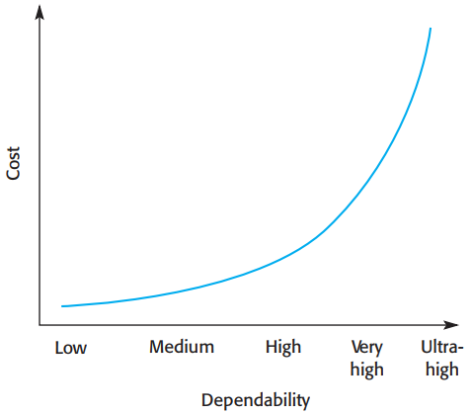

Chap. 10 Dependable Systems
Cost/dependability curve
• Fig. 10.2 shows the relationship between costs and incremental improvements in dependability.
• If your software is not very dependable, you can get significant improvements fairly cheaply by using better software engineering; However, if you are already using good practice, the costs of improvement are much greater, and the benefits from that improvement are less.
• There is also the problem of testing software to demonstrate that it is dependable. As software becomes more dependable, more and more tests are needed to try and assess how many problems remain in the software, this can significantly increase the cost of high-dependability systems.

Slide 14
Chap. 10 Dependable Systems
10.2 Sociotechnical systems 社会技术系统
One of the fundamental characteristics of a system—it is more than the sum of its parts. Systems have properties that become apparent only when their components are integrated and operate together. 系统的基本特性之一：系统大于其部分之和
Software systems are not isolated systems but are part of more extensive systems that have a human, social, or organizational purpose. Therefore software engineering is not an isolated activity but is an intrinsic part of systems engineering. 软件系统是更广泛系统的组成部分；软件工程是系统工程的固有组成部分。

Slide 15
Chap. 10 Dependable Systems
Example: wilderness weather system 举例
The wilderness weather system software controls the instruments in a weather station.
It communicates with other software systems and is a part of wider national and international weather forecasting systems.
As well as hardware and software, these systems include processes for forecasting the weather and people who operate the system and analyze its outputs.
The system also includes the organizations that depend on the system to help them provide weather forecasts to individuals, government and industry.

Slide 16
Chap. 10 Dependable Systems
Concept: Sociotechnical systems 社会技术系统概念
These broader systems are called sociotechnical systems. They include nontechnical elements such as people, processes, and regulations, as well as technical components such as computers, software, and other equipment. 这些更一般的系统称为社会技术系统
System dependability is influenced by all of the elements in a sociotechnical system—hardware, software, people, and organizations. 系统的可依赖性受社会技术系统的所有基本元素的影响
Sociotechnical systems are so complex that it is impossible to understand them as a whole. 过于复杂，无法作为整体来理解

Slide 17
Chap. 10 Dependable Systems
10.3 Redundancy and diversity 冗余和多样性
Strategies to achieve and enhance dependability rely on both redundancy and diversity. 达到可依赖性的策略：冗余和多样性
Redundancy means that spare capacity is included in a system that can be used if part of that system fails. 冗余
Diversity means that redundant components of system are of different types, thus increasing the chances that they will not fail in exactly the same way. 多样性
We use redundancy and diversity to enhance dependability in our everyday lives. We should back up our computers to maintain redundant copies of our data. To avoid problems with disk failure, backups should be kept on a separate, diverse, external device. 例子

Slide 18
Chap. 10 Dependable Systems
Designed for dependability 为可依赖性的设计
Software systems that are designed for dependability may include redundant components that provide the same functionality. 可加入提供相同系统功能的冗余组件
These are switched into the system if the primary component fails. If these redundant components are diverse, a common fault in replicated components will not result in a system failure. 若主构件失效,则切换入系统;若有多样性,就不会导致相同失效
Another form of redundancy is the inclusion of checking code, which is not strictly necessary for the system to function. 另一种冗余，可加入检查代码
This code can detect some kinds of problems, such as data corruption, before they cause failures. It can invoke recovery mechanisms to correct problems to ensure that the system continues to operate. 检测问题、激发恢复机制

Slide 19
Chap. 10 Dependable Systems
Main Uses of redundancy and diversity 主要用途
In systems for which availability is a critical requirement, redundant servers are normally used. These automatically come into operation if a designated server fails. Sometimes, to ensure that attacks on the system cannot exploit a common vulnerability, these servers may be of different types and may run different operating systems. 当可用性是关键需求时
Diversity and redundancy may also be also used in the design of dependable software development processes. In a dependable process, activities such as software validation do not rely on a single tool or technique. This improves software dependability because it reduces the chances of process failure, where human errors made during the software development process lead to software errors. 当设计可依赖软件开发过程时

Slide 20
Chap. 10 Dependable Systems
10.4 Dependable processes 可依赖的过程
Dependable software processes are software processes that are designed to produce dependable software. 含义:产生可依赖软件的软件过程
The rationale for investing in dependable processes is that a good software process is likely to lead to delivered software that contains fewer errors and is therefore less likely to fail in execution. A company using a dependable process can be sure that the process has been properly enacted and documented and that appropriate development techniques have been used for critical systems development. 投资可依赖过程的根本原因

Slide 21
Chap. 10 Dependable Systems
Attributes of dependable processes
Process characteristic | Description
Auditable 可审计 | The process should be understandable by people apart from process participants, who can check that process standards are being followed and make suggestions for process improvement.
Diverse 多样性 | The process should include redundant and diverse verification and validation activities.
Documentable可文档化 | The process should have a defined process model that sets out the activities in the process and the documentation that is to be produced during these activities.
Robust 鲁棒性 | The process should be able to recover from failures of individual process activities.
Standardized 标准化 | A comprehensive set of software development standards covering software production and documentation should be available.

Slide 22
Chap. 10 Dependable Systems
Dependable process characteristics 可依赖过程特性
The evidence that a dependable process has been used is often important. System developers will normally present a model of the process to a regulator, along with evidence that the process has been followed. The regulator also has to be convinced that the process is used consistently by all of the process participants. This means that the process must be: 可依赖过程被使用的证据通常很重要
Explicitly defined: A process that has a defined process model that is used to drive the software production process. Data must be collected during the process that proves that the development team has followed the process as defined in the process model. 明确定义的
Repeatable: A process that does not rely on individual interpretation and judgment. Rather, the process can be repeated across projects and with different team members. 可重复的

Slide 23
Chap. 10 Dependable Systems
Formal methods and dependability (留作自学)

